Slide 1
COMP 2710 Software Construction
Data Flow Diagram
Homework 4 - Design
Dr. Xiao Qin
Auburn University
http://www.eng.auburn.edu/~xqin
xqin@auburn.edu
Fall, 2012
Notes:
See Lecture
Fall’09 Lec03a, Fall’11 Lec03a.
Objectives
Predefined Functions
Those that return a value and those that don’t
Programmer-defined Functions
Defining, Declaring, Calling
Recursive Functions
Scope Rules
Local variables
Global constants and global variables
Blocks, nested scopes

Slide 2
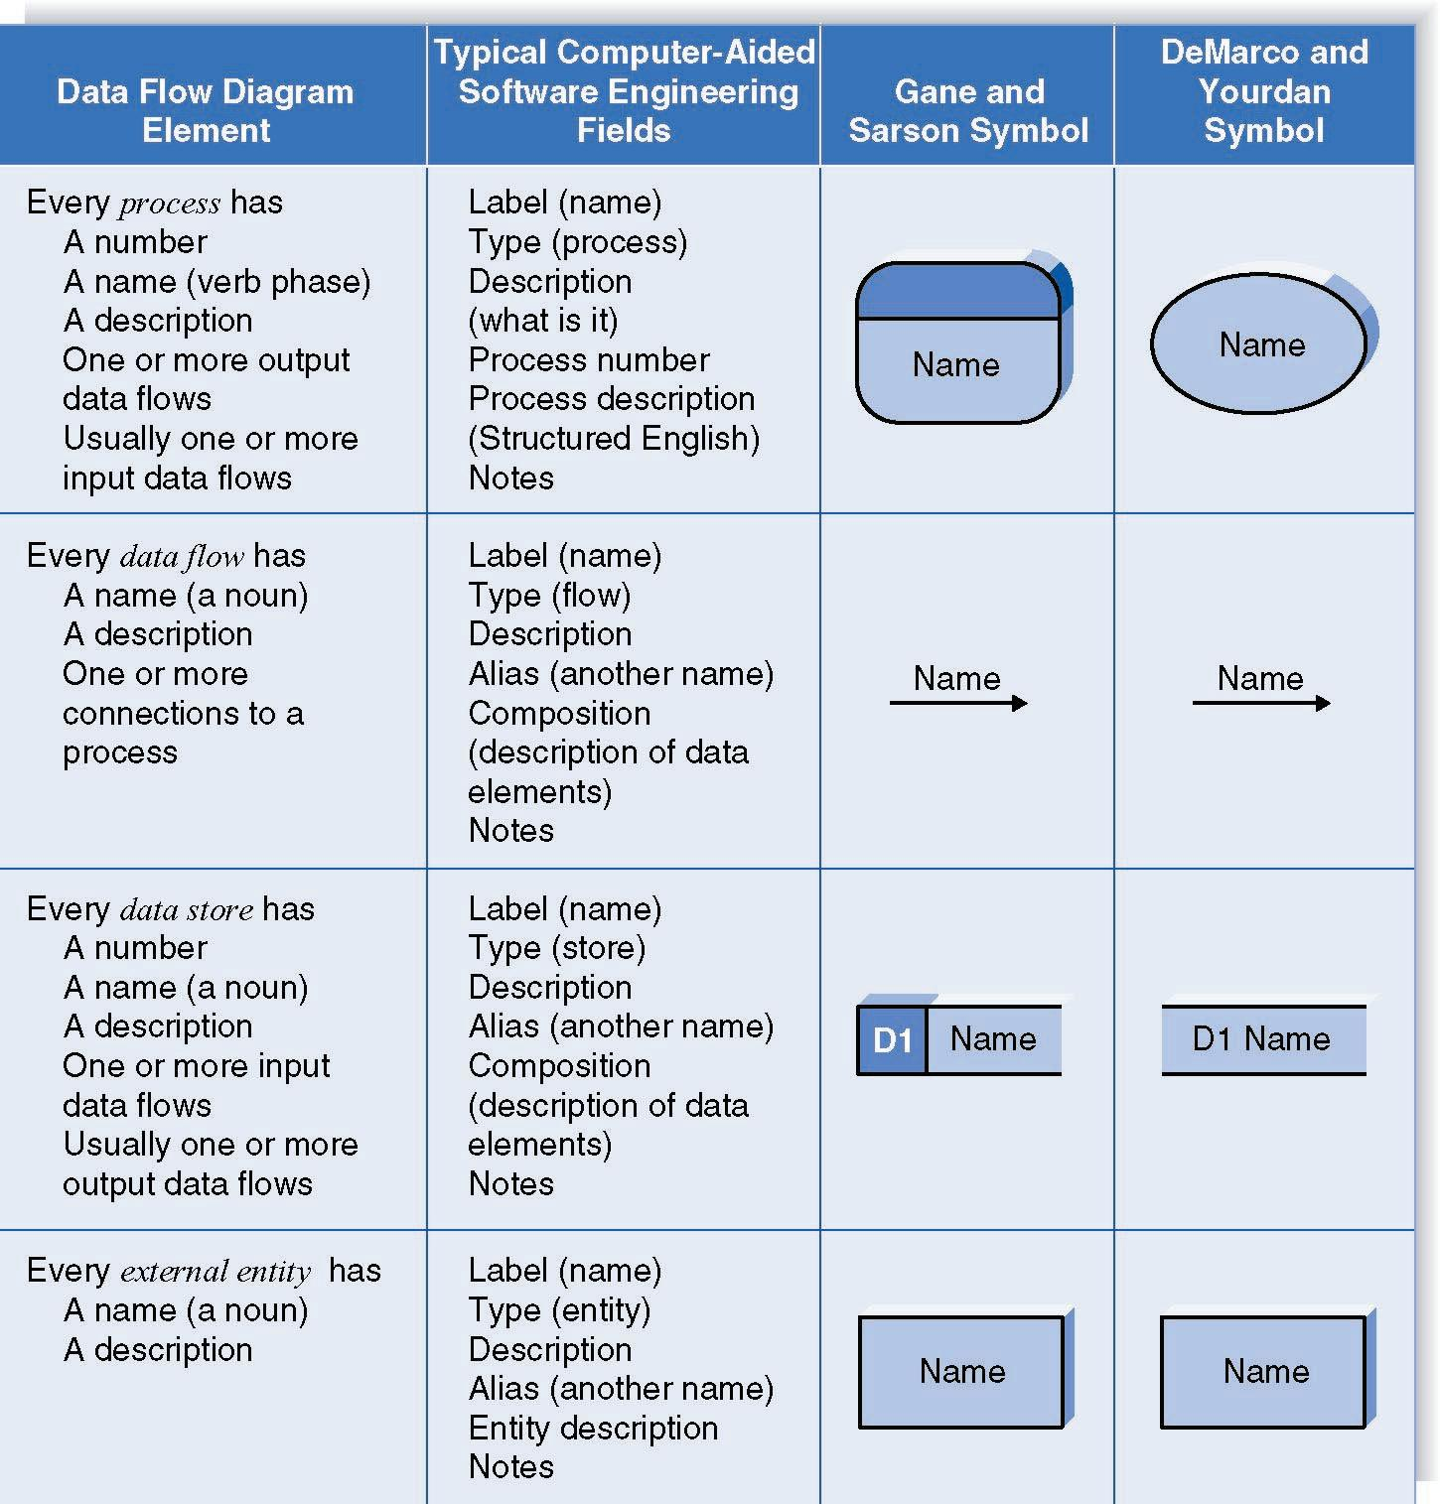
3-<number>

